Slide 1
Supersonic Inlet
AE 2010:
Thermodynamics and Fluids Fundamentals

Slide 2
Supersonic (Engine) Inlets
For air-breathing engines on supersonic vehicles, usually want to slow flow down to subsonic speeds inside engine
  Need diffuser (M>1→M<1) for engine inlet
  Exception: supersonic combustion (e.g., SCRAM jets)
Goal
  Lowest P_{o} loss (highest thrust)
    Given flight M
    Mass flow rate requirement (thrust)
    Stable operation (nothing drastic for small changes in flight conditions)

Slide 3
CD Inlet
Can get close to isentropic flow
  lowest potential p_{o} loss
  starting problem, M∞<M_{design}
  like supersonic wind tunnel,
  have to swallow shock
    can be done by overspeeding: fly above M_{design} until shock sits at entrance
    usually requires variable area throat or bypass valves (heavy, complex)
  stability problem: if “shock” leaves throat, lowering mass flow (higher A₂*)
Not typically used
M∞>1
M<1
+ ΔM

Slide 4
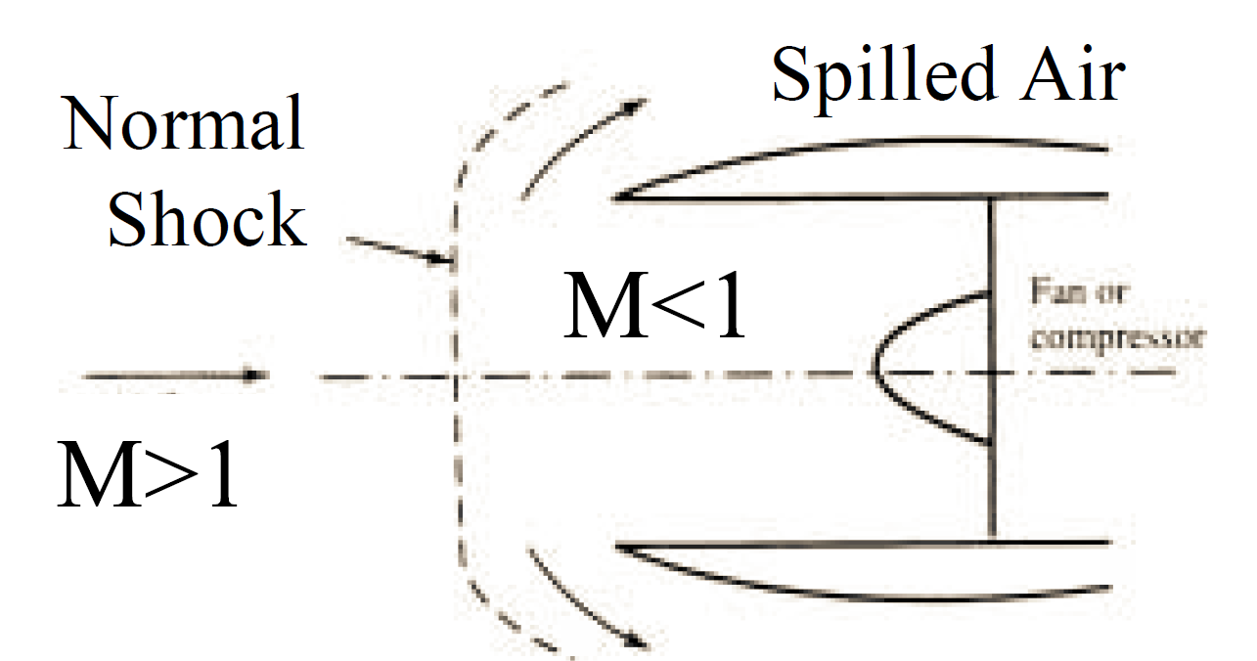
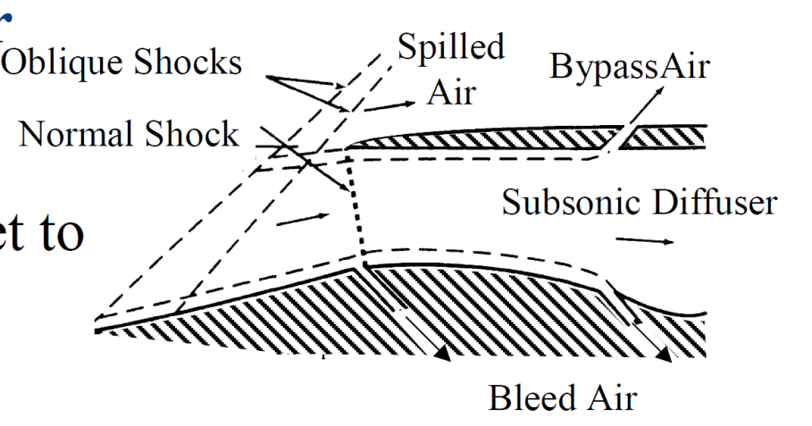
Shock Inlets
Normal shock diffuser
  Simple, diverging section preceded by normal shock
  Highest P_{o} loss (strong shock)
Oblique Shock Diffuser
  Oblique shocks followed by normal shock at (or inside) inlet to subsonic diffuser
  Lower P_{o} loss
  Works for range of M

Slide 5
Example: Normal vs. Oblique Diffusers
Given: You need to pick a diffuser for Mach 2 flight conditions. Your choices are a normal shock diffuser and 2 different oblique shock diffusers
Find: stagnation pressure loss for each (P_{o,final}/P_{o,initial})
Assume: air is TPG/CPG with γ=1.4, stead, adiabatic, no work, inviscid except for shock
M=2
p_{o,final}
p_{o,initial}
p_{o,final}
M=2
20°
p_{o,initial}
M=2
5°
p_{o,final}
p_{o,initial}
10°

Slide 6
Solution: Normal vs. Oblique Diffusers
M₁=2
Analysis:
  Normal shock diffuser
  Single oblique shock (+normal)
M₂, p_{o2}
p_{o1}
M₂, p_{o,2}
M₁=2
M₃, p_{o3}
20°
p_{o1}
B.1
B.1
Normal shock inlet – 28% P_{o} loss
Oblique shock inlet – 13.3% P_{o} loss

Slide 7
Solution: Normal vs. Oblique Diffusers
M₂, p_{o,2}
Analysis:
  Two 5º turns (+normal shock)
M₃, p_{o3}
M=2
5°
p_{o1}
10°
B.1
C.1
B.1
Double oblique shock inlet – 12.7% P_{o} loss
B.1

Slide 8
Double Oblique Inlet - Advantages
So for M=2, same total turning angle (10º)
  Two oblique shocks slightly better than one (12.7% vs. 13.3% P_{o} loss)
  Significant improvement over normal shock alone (28% P_{o} loss)
Oblique shock diffuser with two 10º turns (total δ of 20º) even better
  Only 4.3% P_{o} loss (solution shown on next slide)
  So larger overall deflection can give better P_{o}
Stagnation pressure advantages of using multiple oblique shocks increase with higher M

Slide 9
Double Oblique Shock Diffuser
M₂, p_{o,2}
Two 10º turns (+normal shock)
M₃, p_{o3}
From previous results for 10º turn
M=2
p_{o1}
10°
20°

Slide 10
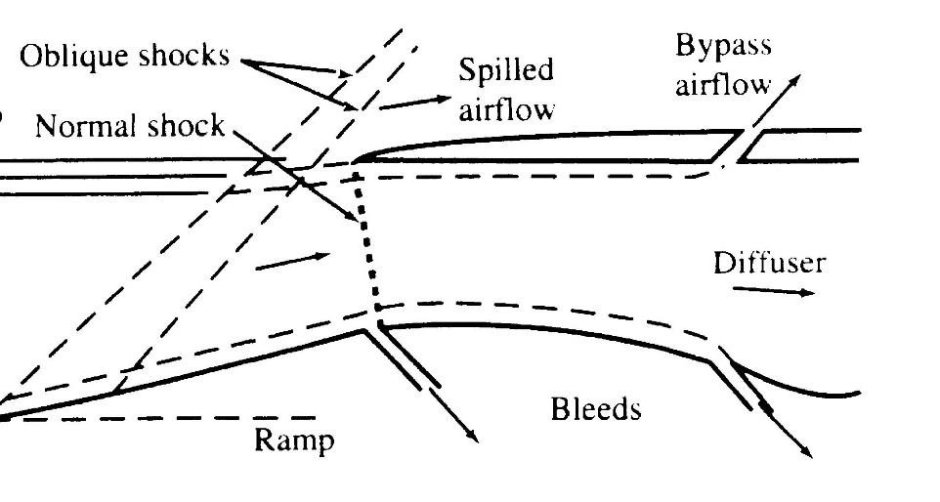
Double Oblique Inlet - Disadvantages
Flow separation
  Since P increases across oblique shocks, the flow sees adverse P gradient
  So more or bigger oblique shocks (or longer external ramp), the greater the chance the boundary layer will separate → major change in flow field, large losses (P_{o} and mass flow rate)
Oblique Shocks
Spilled
Air
BypassAir
Normal Shock
Boundary
Layer
Subsonic Diffuser
Bleed Air
Internal Turn Angle
  Larger total external turn angle showed less P_{o} loss
  Larger external flow turning requires larger inlet
  Also requires larger internal flow turning to get flow back to horizontal

